Slide 1
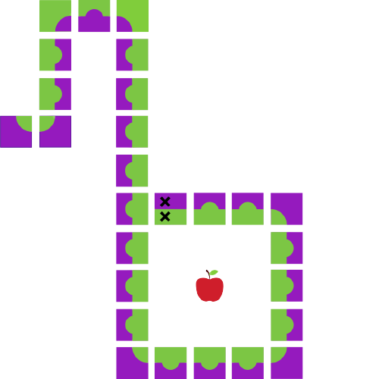
Java Workshop 5
Aadila Ali Sabry

Slide 2
Guess the Number
Notes:
https://replit.com/@AadilaAliSabry/Number-Guessing-Game#Main.java

Slide 3
Fibonacci Sequence
Notes:
https://www.mathsisfun.com/numbers/fibonacci-sequence.html
https://replit.com/@AadilaAliSabry/Fibonacci-Sequence#Main.java

Slide 4
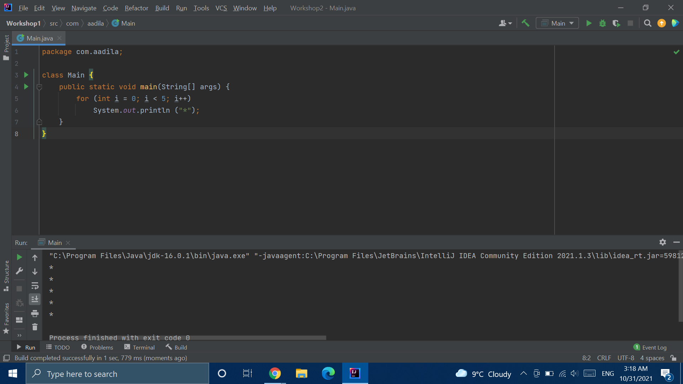
Notes:
No brackets

Slide 5
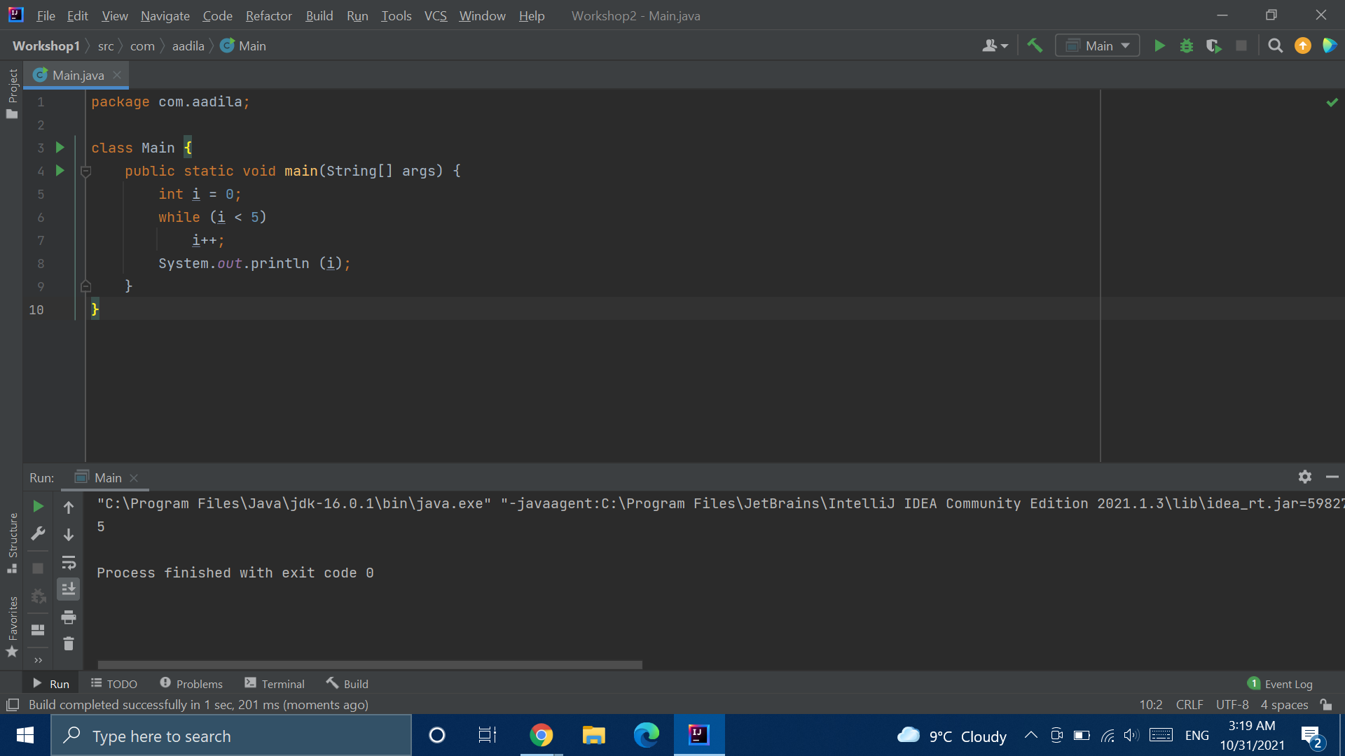

Slide 6
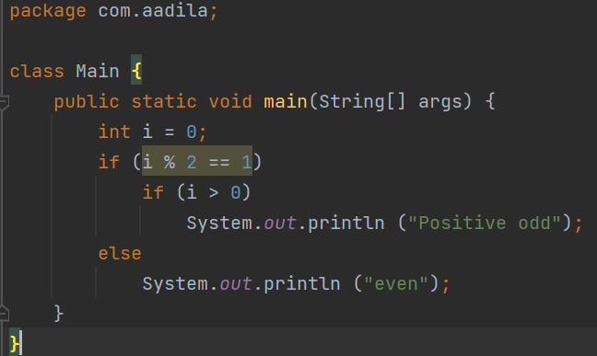

Slide 7

Notes:
Common mistakes:
Assignment vs comparison

Slide 8

Notes:
Common mistakes: semicolon

Slide 9
Break Statements
Notes:
https://replit.com/@AadilaAliSabry/Break-Statements#Main.java

Slide 10
Continue Statements
Notes:
https://replit.com/@AadilaAliSabry/Continue-Statements

Slide 11
Prime Checker
Notes:
https://replit.com/@AadilaAliSabry/Primality-Checker#Main.java

Slide 12
Break Time

Slide 13
Arrays
What do I do if…
I want to store the marks of 30 students in a class?
The prices of every item in a supermarket?
Do I make a new variable for each entry?

Slide 14
Arrays
int [] array_name = {item1, item2, … , itemN};
int array_name [] = {item1, item2, … , itemN};
Curly brackets hold the contents of the array!
Square brackets tell Java that it’s an array. You can put them before or after the name of your array
In this example, I’ve initialized the array as soon as I declared it. You’ll have to use this syntax if you want to initialize immediately
Notes:
Items in array are called elements
Have some functionality that makes iterating over them easy (can use loops vs changing one by one if doing the same thing for all elements
Data type vs int

Slide 15
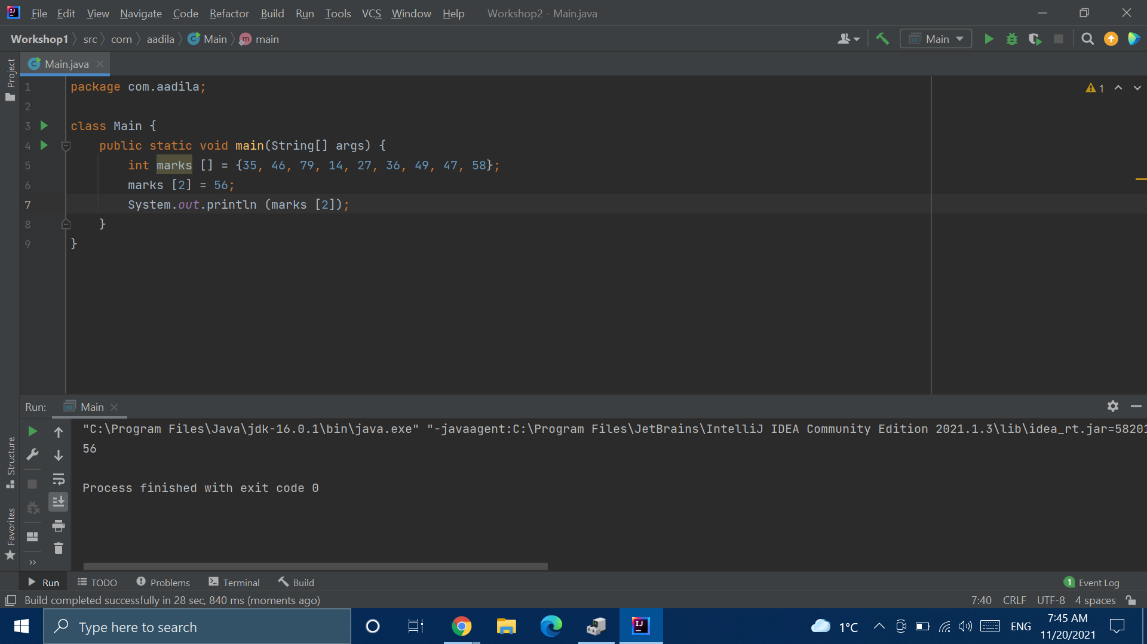
Accessing Array Elements
Notes:
Note: Indexes go from 0 to length - 1 !!!
Which element am i changing in line 2?

Slide 16
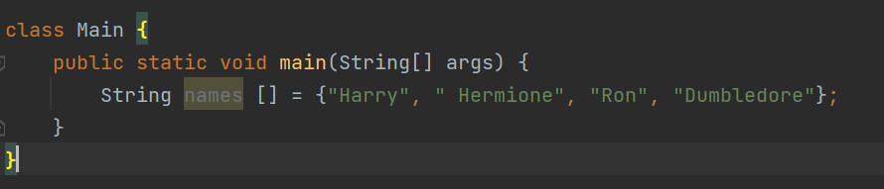
Not only for Type int!

Slide 17
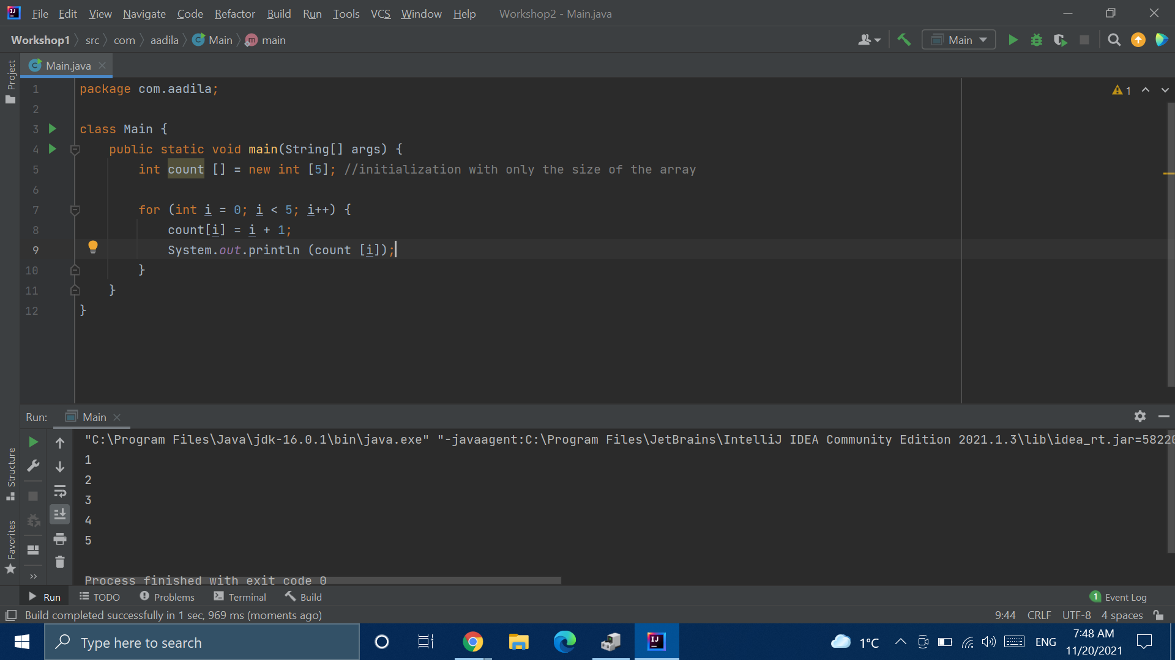
A Different Way to Initialize
Notes:
When would you not want to initialize immediately?
New is a keyword - where else have you seen “new”?

Slide 18
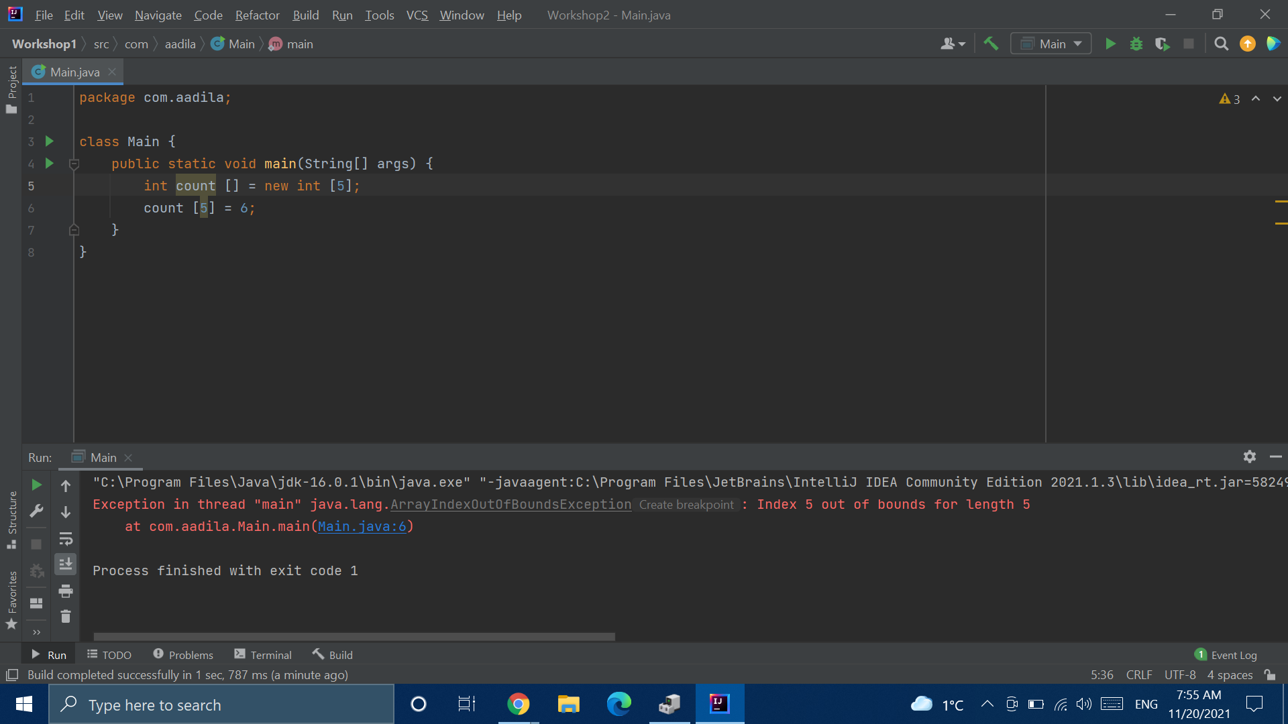
Index Out of Bounds
Notes:
Notice - index 5

Slide 19
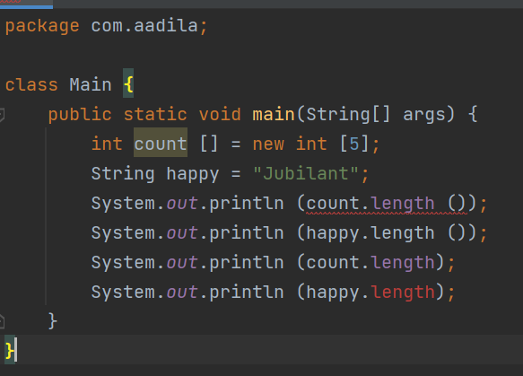
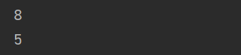
Length of an Array
Notes:
Which lines are producing errors?

Slide 20
Arrays have Fixed Length
Notes:
One type

Slide 21
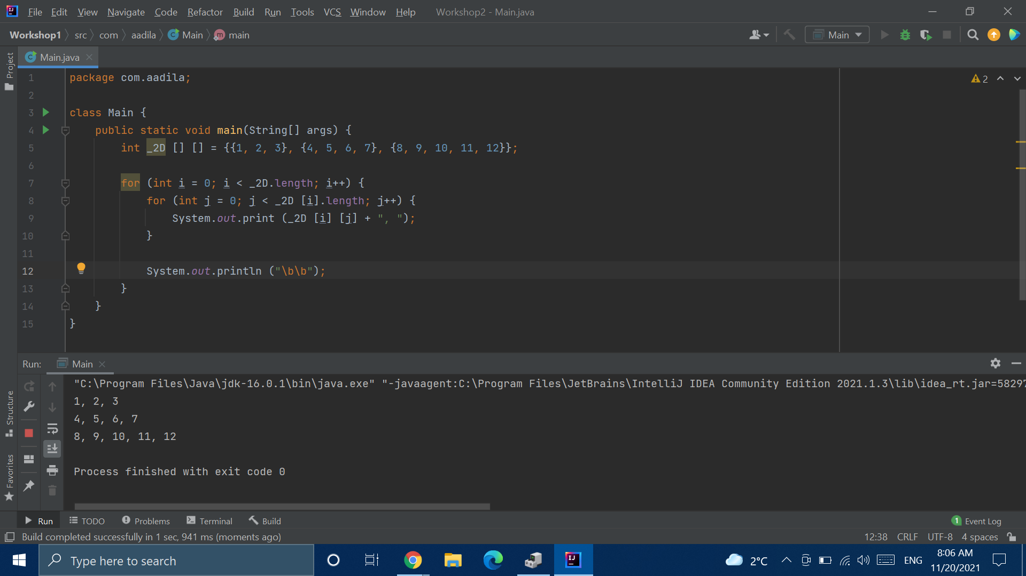
Multidimensional Arrays
Notes:
Notice - multidimensional and not 2d
Notice the escape sequence I’m using
Notice how i access the length of the big array and the smaller arrays contained within it
Array of arrays!

Slide 22
Searching
Notes:
https://replit.com/@AadilaAliSabry/Searching#Main.java

Slide 23
Sorting
Notes:
https://replit.com/@AadilaAliSabry/Sorting#Main.java

Slide 24
Mean, Median and Max
Notes:
https://replit.com/@AadilaAliSabry/Mean-Median-and-Max#Main.java

Slide 25
Shuffle the Deck
Notes:
https://replit.com/@AadilaAliSabry/Shuffle-the-Deck#Main.java

